Slide 1
Data Warehousing - session -5
Mr. Atul Vaze
Certified BI Specialist(OBIEE)
Certified Agile Coach (ICP-ACC)
Function Point Specialist
Six Sigma GB

Slide 2
TOPICS
Changing Dimensions
problems of changing dimensions
Techniques to handle changing dimensions
Mini dimension
Examples for mini-dimensions and outriggers
Monster Dimension
Multi-valued Dimensions
Time dimension
Conformed dimension
Explain enterprise bus architecture
Bridge Table
Role-playing dimensions
Factless fact tables

Slide 3
Books
Text Books:
T1: Ponniah P, “Data Warehousing Fundamentals”, Wiley Student Edition, 2012
T2: Kimball R, “The Data Warehouse Toolkit”, 3e, John Wiley, 2013
Reference Books :
R1 : Anahory S, & Dennis M, “Data Warehousing in the Real World”, Pearson Education, 2008.
R2 : Kimball R, Reeves L, Ross M, & Thornthwaite, W, “The Data Warehouse Lifecycle Toolkit”, John Wiley, 2e, 2012.
R3: Jiawei Han, Micheline Kamber and Jian Pei, “Data Mining: Concepts and Techniques”, Morgan Kaufmann Publishers 2012
R4: Krish Krishnan, “Data Warehousing in the Age of Big Data”, Morgan Kaufmann Publishers 2013
Note: In order to broaden understanding of concepts as applied to Indian IT industry, students are advised to refer books of their choice and case-studies in their own organizations

Slide 4
Changing Dimensions
Slowly Changing Dimensions
Rapidly Changing Dimensions
Small Dimensions
Monster Dimensions

Slide 5
Slowly Changing Dimensions (SCDs)
Type I Change (overwrite)
Type II Change (new record)
Type III Change (new attribute)
Hybrid Approach
  Predictable changes with multiple version overlays
  Unpredictable changes with single version overlays

Slide 6
Slowly Changing Dimensions (SCDs)
Slowly Changing Dimensions (SCD) -
Dimensions that change slowly over time, rather than changing on regular schedule, time-base.
In Data Warehouse there is a need to track changes in dimension attributes in order to report historical data. In other words, implementing one of the SCD types should enable users assigning proper dimension's attribute value for given date.
  Example of such dimensions could be: customer, geography, employee.
  There are many approaches how to deal with SCD. The most popular are:
  Type 0 - The passive method
  Type 1 - Overwriting the old value
  Type 2 - Creating a new additional record
  Type 3 - Adding a new column
  Type 4 - Using historical table
  Type 6 - Combine approaches of types 1,2,3 (1+2+3=6)
Notes:
Changing values of the dimension table

Slide 7
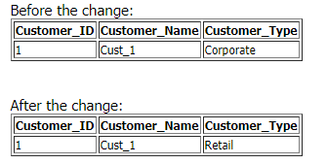
Slowly Changing Dimensions (SCDs)
Type 0 -Retain Original The passive method. In this method no special action is performed upon dimensional changes. Some dimension data can remain the same as it was first time inserted, others may be overwritten.
Type 1 - Overwriting the old value. In this method no history of dimension changes is kept in the database. The old dimension value is simply overwritten by the new one. This type is easy to maintain and is often use for data which changes are caused by processing corrections(e.g. removal special characters, correcting spelling errors).

Slide 8
Type 1 - Overwriting the old value
Advantages:
- This is the easiest way to handle the Slowly Changing Dimension problem, since there is no need to keep track of the old information.
Disadvantages:
- All history is lost. By applying this methodology, it is not possible to trace back in history.
  For example, in this case, the customer type would not be able to know that it was retail before.
Usage:
About 50% of the time.
When to use Type 1:
Type 1 slowly changing dimension should be used when it is not necessary for the data warehouse to keep track of historical changes.

Slide 9
SCD- Type 2-Add New Row
Type 2 - Creating a new additional record/Add New Row.
In this methodology all history of dimension changes is kept in the database.
A minimum of three additional columns should be added to the dimension row
with type 2 changes:
1) row effective date or date/time stamp;
2) row expiration date or date/time stamp; and
3) current row indicator.
Also 'effective date' and 'current indicator' columns are used in this method.
There could be only one record with current indicator set to 'Y'. For 'effective date' columns, i.e. start_date and end_date, the end_date for current record usually is set to value 9999-12-31.
Introducing changes to the dimensional model in type 2 could be very expensive database operation so it is not recommended to use it in dimensions where a new attribute could be added in the future

Slide 10
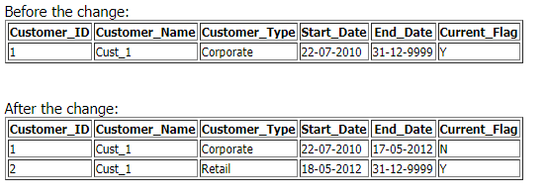
Type2 -Example

Slide 11
SCD- Type2
Advantages:
- This allows us to accurately keep all historical information.
Disadvantages:
- This will cause the size of the table to grow fast. In cases where the number of rows for the table is very high to start with, storage and performance can become a concern.
- This necessarily complicates the ETL process.
Usage:
About 50% of the time.
When to use Type 2:
Type 2 slowly changing dimension should be used when it is necessary for the data warehouse to track historical changes.

Slide 12
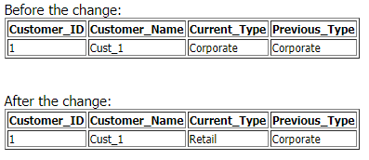
SCD- Type 3-Add New Attribute
In this type usually only the current and previous value of dimension is kept in the database.
The new value is loaded into 'current/new' column and the old one into 'old/previous' column.
Generally speaking the history is limited to the number of column created for storing historical data. This is the least commonly needed technique.

Slide 13
SCD- Type 3
Advantages:
- This does not increase the size of the table, since new information is updated.
- This allows us to keep some part of history.
Disadvantages:
- Type 3 will not be able to keep all history where an attribute is changed more than once.
Usage:
Type 3 is rarely used in actual practice.
When to use Type 3:
Type 3 slowly changing dimension should only be used when it is necessary for the data warehouse to track historical changes, and when such changes will only occur for a finite number of time.

Slide 14
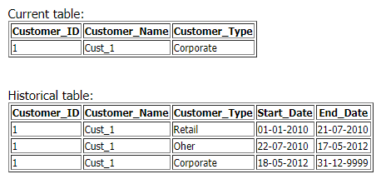
SCD- Type-4 -Using historical table
In this method a separate historical table is used to track all dimension's attribute historical changes for each of the dimension.
The 'main' dimension table keeps only the current data e.g. customer and customer_history tables.

Slide 15
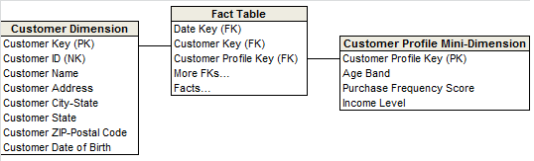
Type 4: Add a Mini-dimension
The type 4 technique is used when a group of attributes in a dimension rapidly
changes and is split off to a mini-dimension.
This situation is sometimes called a rapidly changing monster dimension.
Frequently used attributes in multimillion-row dimension tables are mini-dimension design candidates, even if they don’t frequently change.
The type 4 mini-dimension requires its own unique primary key; the primary keys of both the base dimension and mini-dimension are captured in the associated fact tables.
Prof. Atul Vaze, BITS, Pilani

Slide 16
SCD- Type 5: Add Mini-Dimension and Type 1 Outrigger
The type 5 technique is used to accurately preserve historical attribute values, plus report historical facts according to current attribute values.
Type 5 builds on the type 4 mini-dimension by also embedding a current type 1 reference to the mini-dimension in the base dimension. This enables the currently-assigned mini-dimension attributes to be accessed along with the others in the base dimension without linking through a fact table.
Logically, it represent the base dimension and mini-dimension outrigger as a single table in the presentation area.
The ETL team must overwrite this mini-dimension reference whenever the current mini-dimension assignment changes

Slide 17
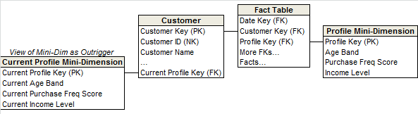
Type 5: Mini-dimension & Type 1 Outrigger
4+1=5!!
Type 4 mini-dimension with type 1 outrigger
Both mini-dimension & outrigger exist

Slide 18
Type 5: Mini-dimension & Type 1 Outrigger
Why not implement it as Type 2 outrigger?
We would then be capturing volatile changes in the monster customer dimension
  A problem that we set out to solve using Type 4!!

Slide 19
Type 5: Mini-dimension & Type 1 Outrigger
Current profile count can be found out in the absence of FT metrics

Slide 20
SCD-Type 6 - Combine approaches of types 1,2,3 (1+2+3=6). (Add Type 1 Attributes to Type 2 Dimension)
In this type we have in dimension table such additional columns as:
current_type - for keeping current value of the attribute. All history records for given item of attribute have the same current value.
historical_type - for keeping historical value of the attribute. All history records for given item of attribute could have different values.
start_date - for keeping start date of 'effective date' of attribute's history.
end_date - for keeping end date of 'effective date' of attribute's history.
current_flag - for keeping information about the most recent record.
In this method to capture attribute change we add a new record as in type 2. The current_type information is overwritten with the new one as in type 1. We store the history in a historical_column as in type 3.

Slide 21
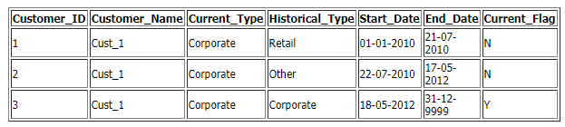
SCD-Type 6 - Combine approaches of types 1,2,3 (1+2+3=6).

Slide 22
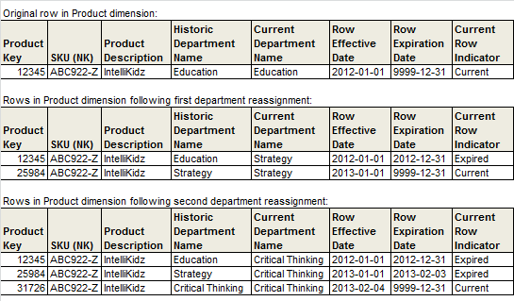
Type 6: Add Type 1 attributes to Type 2 dimension
Combines Type 1, 2, & 3!!
1+2+3=6 and also 1*2*3=6!!
Notes:
Combines Type 1, 2, & 3!!
1+2+3=6 and also 1*2*3=6!!

Slide 23
Type 7: Dual Type 1 and Type 2 Dimensions
Type 7 is the final hybrid technique used to support both as-was and as-is reporting.
A fact table can be accessed through a dimension modeled both as a type 1 dimension showing only the most current attribute values, or as a type 2 dimension showing correct contemporary historical profiles. The same dimension table enables both perspectives.
Both the durable key and primary surrogate key of the dimension are placed in the fact table.
  For the type 1 perspective, the current flag in the dimension is constrained to be current, and the fact table is joined via the durable key.
  For the type 2 perspective, the current flag is not constrained, and the fact table is joined via the surrogate primary key. These two perspectives would be deployed as separate views to the BI applications.

Slide 24
Type 7: Dual Type 1 and Type 2 Dimensions
7 is just a number here!!
Is it feasible to support both the current & historic perspectives for 150 attributes in a large dimension table?
Enter Type 7 hybrid
Include the Natural Key as a FK in the FT along with the Surrogate Key for Type 2 tracking
If NK is unwieldy or ever reassigned, use a separate supernatural key instead

Slide 25
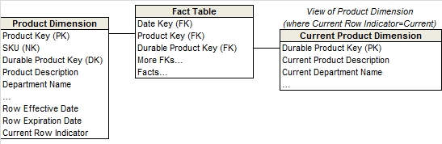
Type 7: Dual Type 1 & Type 2 dimensions

Slide 26
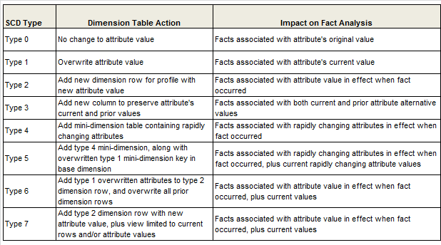
Summary: Type 1 to Type 7

Slide 27
Monster Dimension
Customer dimensions can be very wide
    - Dozens or hundreds of attributes
Customer dimensions can be very large
  - Tens of millions of rows in some warehouses
  - Sometimes includes prospects as well as actual customers
Size can lead to performance challenges
  - One case when performance concerns can trump simplicity
  - Can we reduce width of dimension table?
  - Can we reduce number of rows that get added by implementing Type 2?

Slide 28
Rapidly Changing Monster Dimensions:
The Worst Scenario
Multi-million customer dimension present unique challenges that warrant special treatment
Type-2 SCD not recommended
Business users often want to track the many changes to customer attributes
Insurance companies must update information about their customers and their specific insured automobiles & homes
Throws browsing performance and change-tracking challenges
SOLUTION!!!

Slide 29
Mini-Dimensions
Single technique to handle browsing-performance & change tracking problems
Separate out frequently analyzed or frequently changing attributes into a separate dimension, called mini-dimension
Separate out a package of demographic attributes into a demographic mini-dimension. Age, gender, marital status, no. of children, income level, etc. One row in mini-dimension for each unique combination of these attributes

Slide 30
Mini-Dimensions
Demographic Key | AGE | GENDER | INCOME LEVEL
1 | 20-24 | M | < 20000
2 | 20-24 | M | 20K-24999
3 | 20-24 | M | 25K-29999
18 | 25-29 | M | 20K-24999
10 | 25-29 | M | 25K-29999

Slide 31
Mini-Dimensions
Mini-dimension can not be itself allowed to grow very large
5 demographic attributes
Each attribute can take 10 distinct values
How many rows in mini-dimension?
10,0000

Slide 32
Creating Mini-Dimensions
Include foreign keys to both customer dimension & mini-dimension in fact table

Slide 33
Mini-Dimensions
Advantages :
- History preserved without space blow-up
- FT captures historical record of attribute values
- Mini-dimension has small no. of rows
- # of unique combinations of MD attributes is small
- Consequence of discretization
- 5 attributes with 10 possible values has 100000 rows
- Limit no. of attributes in a single MD
- Improves performance for queries that use MD
- Atleast those queries that don’t use main customer dim.

Slide 34
Mini-Dimensions
Disadvantages :
- Fact table width increases
- Due to increase in no. of dimension foreign keys
- Information lost due to discretization
- Less detail is available
- Impractical to change bucket/band boundaries
- Additional tables introduced
- Users must remember which attributes are in mini- dimension vs. main customer dimension

Slide 35
Mini Dimension Examples

Slide 36
Mini Dimension Example
Customer key
Last name
First name
…
Age
Gender
Income level
…
Customer key
Last name
First name
…
Customer dimension has attributes removed
Age
Gender
Income level
A new dimension is created

Slide 37
Mini Dimension Example
Dimensions
Fact table
Customer key
Last name
First name
…
Customer key
Demographics key
Other keys
facts
Demographics key
Age
Gender
Income level
Another FK must be added to the fact table for mini-dimension
Demographics minidimension
© Ron McFadyen

Slide 38
Snowflaking & Outriggers
Snowflaking is removal of low cardinality columns from dimension tables to separate normalized tables.
Snowflaking not recommended
    User presentation becomes difficult
    Negative impact on browsing performance
    Query response time suffers
    Prohibits the use of Bitmap Indexes
Some situations permit the use of dimension outriggers
Outriggers have special characteristics that make them permissible snowflakes
Notes:
In the context of databases, cardinality refers to the uniqueness of data values contained in a column. High cardinality means that the column contains a large percentage of totally unique values. Low cardinality means that the column contains a lot of “repeats” in its data range.

Slide 39
Outrigger Tables
Limited normalization of large dimension table to save space
Identify attribute sets with these properties:
  Highly correlated
  Low in cardinality (compared to # of customers)
  Change in unison
Example:
  A set of data from an external data provider consisting of 150 demographic & socioeconomic attributes regarding the customer’s district of residence. Data for all customers residing in a particular district is identical. Instead of repeating this large block of data for all customers, we model it as an outrigger
Follow these steps for each attribute set:
  Create a separate “outrigger dimension” for each attribute set
  Remove the attributes from the customer dimension
  Replace with a foreign key to the outrigger table
  No foreign key from fact row to outrigger
    Outrigger attributes indirectly associated with facts via customer dim.
Notes:
Example:
External data provider computes demographic data for each county
100 demographic attributes are provided
Updates are supplied every six months

Slide 40
Outrigger Example
Customer Dimension
Cust_id | FName | LName | Zip | Demo_id
1 | Brian | Babcock | 94403 | 34
2 | Rajeev | Motwani | 94303 | 12
3 | Leland | Stanford | 94305 | 12
Demo_id | County | AvgInc | HHold Size | …
12 | Santa Clara | 78000 | 2.3 | …
… | … | … | … | …
34 | San Mateo | 67000 | 2.5 | …
County
Demographics
Outrigger

Slide 41
Mini dimension Outrigger Example
Fact table
Customer key
Last name
First name
…
demographicFK
Customer key
Demographics key
Other keys
facts
To facilitate customer analysis
Most recent
Demographics key
Age
Gender
Income level
© Ron McFadyen

Slide 42
Outriggers
Reasons:
Demographic data is available at a significantly different grain than the primary dimension data (district vs. individual customer)
The data is administered & loaded at different times than the rest of the data in the customer dimension
Advantages:
  Space savings
    - Customer dimension table becomes narrower
    - Outrigger table has relatively few rows
    - One copy per district vs. one copy per customer
Disadvantages:
  Additional tables introduced
    - Accessing outrigger attributes requires an extra join
    - Users must remember which attributes are in outrigger vs. main customer dimension
    - Creating a view can solve this problem

Slide 43
Outriggers
Dimension outriggers are permissible, but they should be exceptions rather than the rule
Avoid having too many outriggers in your schema
If query tool insists on a classic star schema, we can hide the outrigger under a view declaration

Slide 44
Outriggers vs. Mini-Dimensions
Customer
Dimension
Customer
Dimension
Fact
Fact
Outrigger
Mini-dimension

Slide 45
Case Study:
Techniques to handle changing dimensions

Slide 46
Case Study:
Techniques to handle changing dimensions
A dimensions is said to fast changing or rapidly changing dimensions if one or more of its attributes changes very fast and in many rows.
  e.g. Consider a Employee dimensions where there are 1000 rows in it.
  On an average each employee changes its 10 attribute in a year. Now if use type
  2 approach to manage change it will be 1000 * 10 = 10000 rows still manageable right. Now if we have 1 million rows it becomes un-manageable using type two approach it becomes huge.
So this dimension qualifies to be fast changing dimension. We can handle this using mini-dimensions.

Slide 47
Mini Dimension
How to create mini dimension:
First identify the changing attributes e.g. Age, Income, Productivity Score, Weight
2. Convert these attribute values in to range or bands.
3. Create and insert all possible combination of these attributes in a dimension table called mini dimension.
4. Now join this mini dimensions to the fact table.
Employee_mini_dim

Slide 48
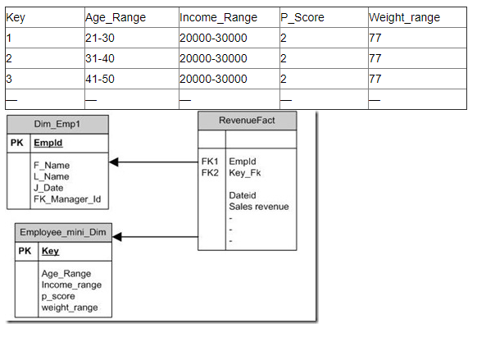
Mini Dimension

Slide 49
TIME DIMENSION
The Time Dimension is the one dimension nearly guaranteed to be in every data mart because virtually every data mart is a time series.
In fact, date is usually the first dimension in the underlying sort order of the database so that the successive loading of time intervals of data is placed into virgin territory on the disk.
Data warehouses always need an explicit time Dimension table. There are many date attributes not supported by the SQL date function, including fiscal periods, weeks number, quarter number, and weekends. Rather than attempting to determine these nonstandard calendar calculations in a query, we should look them up in a date dimension table.

Slide 50
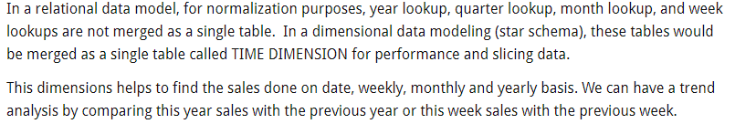
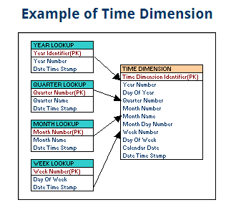
Time Dimension

Slide 51
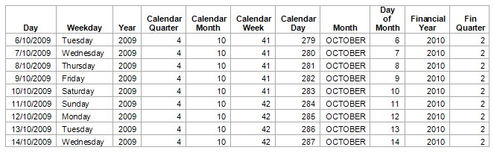
Time Dimension

Slide 52
Conformed Dimension
A conformed dimension is a dimension that has exactly the same meaning and content when being referred from different fact tables.
A conformed dimension can refer to multiple tables in multiple data marts within the same organization.
For two dimension tables to be considered as conformed, they must either be identical or one must be a subset of another.
There cannot be any other type of difference between the two tables.
  For example, two dimension tables that are exactly the same except for the primary key are not considered conformed dimensions.
Dimension tables conform when attributes in separate dimension tables have the same column names and domain contents
Information form separate fact tables can be combined in a single report by using conformed dimension attributes that are associates with each fact table
Conformed dimensions are reused across fact tables

Slide 53
Conformed Dimensions
Bottom-up data warehousing approach builds one data mart at a time
Drill-across between data marts requires common dimension tables
Common dimensions and attributes should be standardized across data marts
Create master copy of each common dimension table
Three types of “conformed” dimensions:
  Dimension table identical to master copy
  Dimension table has subset of rows from the master copy
    Can improve performance when many dimension rows are not relevant to a particular process
  Dimension table has subset of attributes from master copy
    Allows for roll-up dimensions at different grains (used in Aggregation)

Slide 54
Conformed Dimension Example
Monthly sales forecasts
  Predicted sales for each brand in each district in each month
  POS Sales fact recorded at finer-grained detail
    Product SKU vs. Brand
    Date vs. Month
    Store vs. District
Use roll-up dimensions
  Brand dimension is rolled-up version of master Product dimension
    One row per brand
    Only include attributes relevant at brand level or higher
  Month dimension is rolled-up Date
  District dimension is rolled-up Store
Brand, Month, & District are conformed dimensions

Slide 55
Conformed Facts
If the same measurement appears in separate fact tables, care must be taken to make sure that technical definitions of the facts are identical if they are to be compared or computed together
If separate fact definitions are consistent, the conformed facts should be identically named, otherwise they should be differently named
  Examples: Revenue, profit, standard prices & costs, measures of quality and customer satisfaction and other KPIs are facts that must conform
95% of data architecture effort goes in designing conformed dimensions and only 5% effort goes into establishing conformed facts definitions

Slide 56
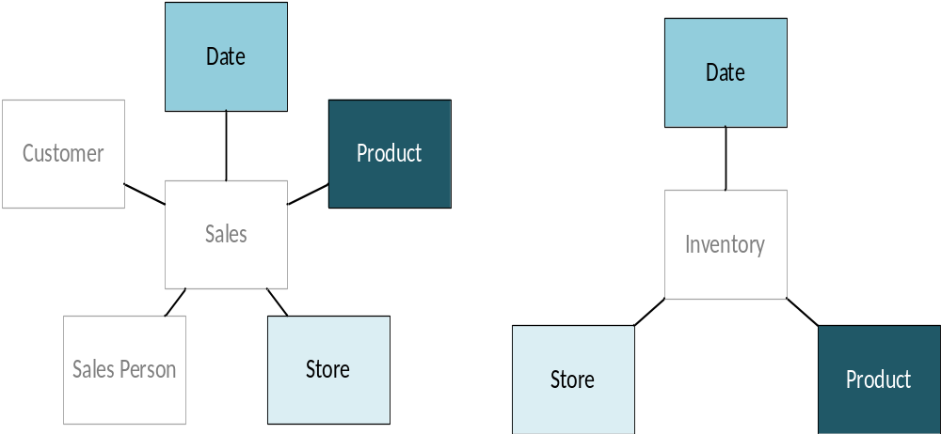
Facts are related through dimensions…
Sales Process
Inventory Process
Notes:
But there are usually dimensions in common
GMROII (Gross Margin Return on Inventory Investment)

Slide 57
Conformed Dimensions
A conformed dimension is a set of data attributes that have been physically referenced by multiple fact tables using the same key value to refer to the same structure, attributes, domain values, definitions and concepts.
Dimensions are conformed when they are either exactly the same (including keys) or one is a perfect subset of the other.
Dimension tables are NOT conformed if the attributes are labeled differently or contain different values.

Slide 58
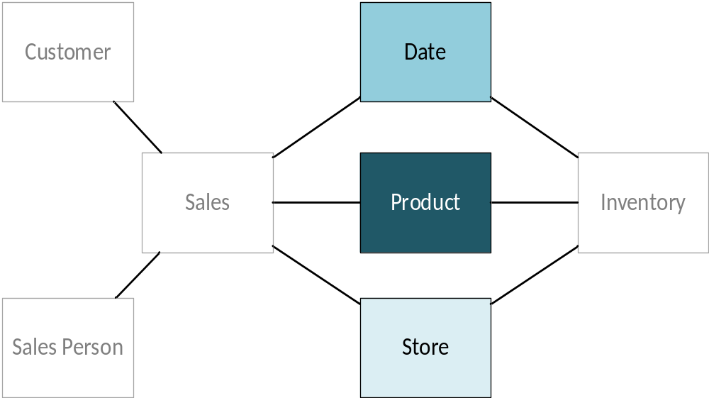
Facts are related through dimensions…
By linking facts through conformed dimensions, cross-process analysis is possible
Notes:
MUST BE IDENTICAL
By linking facts through conformed dimensions, cross-process analysis is possible
Wikipedia (http://en.wikipedia.org/wiki/Dimension_(data_warehouse)#Conformed_dimension)

Slide 59
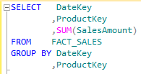
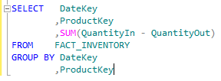
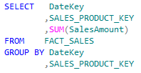
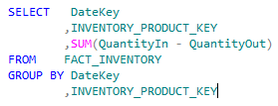
Dimensions: Conformed vs Un-conformed

Slide 60
Explain enterprise bus architecture

Slide 61
Explain enterprise bus architecture
The enterprise data warehouse bus architecture provides a rational approach to decomposes the DW/BI planning process into manageable pieces by focusing on the organization’s core business processes, along with the associated conformed dimensions.
The bus architecture is independent of technology and database platforms.
All flavors of relational and OLAP-based dimensional models can be full participants in the enterprise data warehouse bus if they are designed around conformed dimensions and facts.
DW/BI systems consist of separate machines with different operating systems and database management systems.
Notes:
CS5.2.2 = Explain enterprise bus architecture (T2, Ch 4)

Slide 62
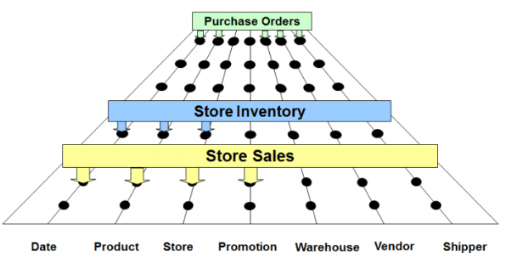
Enterprise data warehouse bus with shared dimensions
(Benefits of Confirmed Dimension)
Conformed dimensions are common, standardized, master dimensions that are managed once in the ETL system and then reused by multiple fact tables.
Conformed dimensions deliver consistent descriptive attributes across dimensional models.
They support the ability to drill across and integrate data from multiple business processes.
Finally, reusing conformed dimensions shortens the time-to-market by eliminating redundant design and development efforts.
Notes:
CS5.2.2 = Explain enterprise bus architecture (T2, Ch 4)
https://www.kimballgroup.com/data-warehouse-business-intelligence-resources/kimball-techniques/kimball-data-warehouse-bus-architecture/

Slide 63
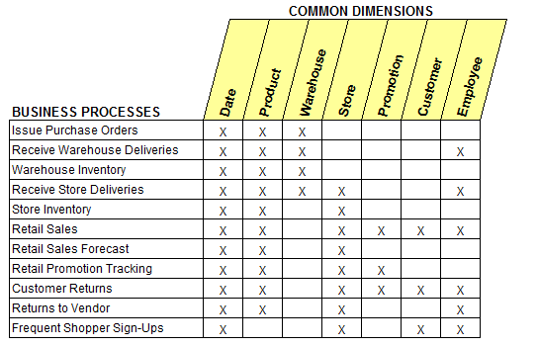
Common Dimensions used across Business Processes

Slide 64
Multi-valued Dimensions

Slide 65
Multi-valued Dimensions
In a classic dimensional schema, each dimension attached to a fact table has a single value consistent with the fact table’s grain. But there are a number of situations in which a dimension has multivalued.
  For example, a patient receiving a healthcare treatment may have multiple simultaneous diagnoses. In these cases, the multivalued dimension must be attached to the fact table through a group dimension key to a bridge table with one row for each simultaneous diagnosis in a group.
A multivalued bridge table may need to be based on a type 2 slowly changing dimension.
  For example, the bridge table that implements the many-to-many relationship between bank accounts and individual customers usually must be based on type 2 account and customer dimensions.
  In this case, to prevent incorrect linkages between accounts and customers, the bridge table must include effective and expiration date/time stamps, and the requesting application must constrain the bridge table to a speciﬁc moment in time to produce a consistent snapshot.

Slide 66
Bridge Tables
An account can have one, two or more customers associated with it
Account to Customer BRIDGE table
Fact
Table
Account
Dimension
Bridge
Table
Customer
Dimension
account_id
account_id
account_id
customer_id
Account-
related
attributes
customer_id
Customer-
related
attributes
weight

Slide 67
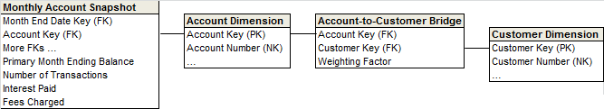
Bridge Tables

Slide 68
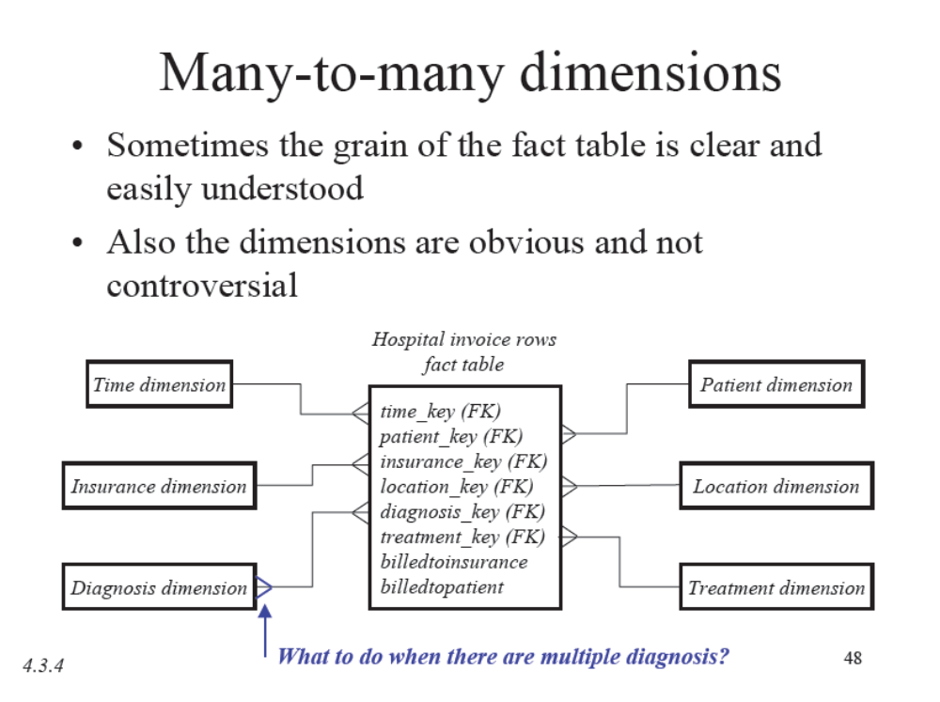

Slide 69
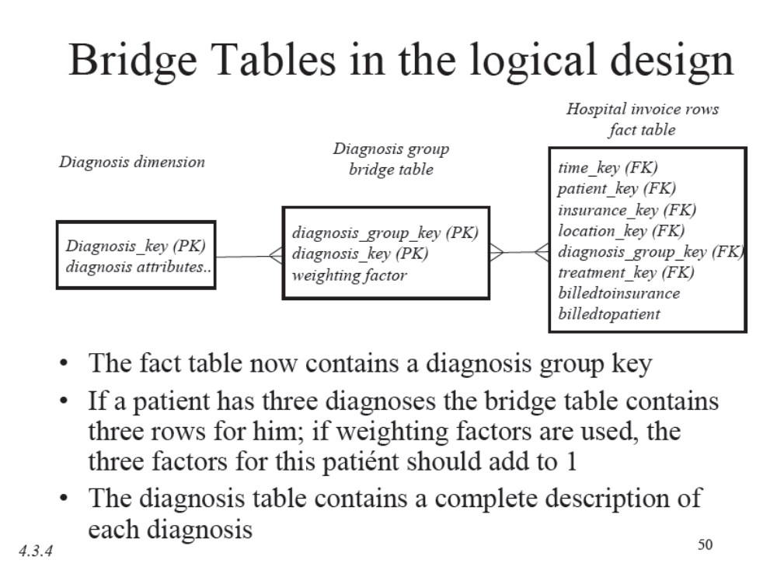
Multi-valued Dimensions:
Healthcare Example
Modeling Diagnoses Dimension: 4 ways:
    Disqualify the Diagnosis Dimension because it is MV
    Choose primary diagnosis & ignore others
    Extend the dimension list to have a fixed number of Diagnosis dimensions Location
    Put a helper table in between this fact table and the Diagnosis dimension table

Slide 70
Role Playing Dimension

Slide 71
Role-Playing Dimension
A single physical dimension can be referenced multiple times in the same fact table
Each reference linking to a logically distinct role for the dimension
  For example, a fact table can have several dates, each of which is represented by a FK to the date dimension
It is essential that each FK refers to a separate view of the date dimension so that references are independent
Separate dimension views (with unique attribute column names) are called ROLES

Slide 72
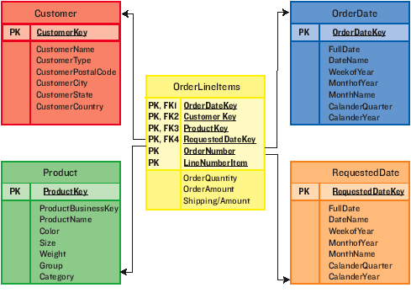
Example
Could not have joined them to the same date dimension- SQL would interpret it as a two –way simultaneous join

Slide 73
Role-Playing Dimension
Consider a fact table to record the status and final disposition of a customer order
Dimensions of this table could be Order Date, Packaging Date, Shipping Date, Delivery Date, Payment Date, Return Date, Refer to Collection Date, Order Status, Customer, Product, Warehouse, and Promotion
Date dimension appears multiple times in the fact table

Slide 74
Role-Playing Dimension
create view order_date
(order_date_key, order_day_of_week, order_month, …..)
as select date_key, day_of_week, month, …
from date_dimension
create view package_date
(package_date, package_day_of_week, package_month, …..)
as select date_key, day_of_week, month, …
from date_dimension

Slide 75
Role-Playing Dimension-Example-2
Another Example
Frequent Flyer flight segment Fact Table need to include
  Flight Date,
  Segment Origin Airport,
  Segment Destination Airport,
  Trip Origin Airport,
  Trip Destination Airport,
  Flight,
  Fare Class, and
  Customer.
The 4 Airport dimensions are 4 different roles played by a single underlying Airport table

Slide 76
Factless Fact Tables

Slide 77
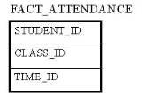
Factless Fact Table
A factless fact table is a fact table that does not have any measures. It is essentially an intersection of dimensions. On the surface, a factless fact table does not make sense, however, there are situations where having this kind of relationship makes sense in data warehousing.
For example, think about a record of student attendance in classes. In this case, the fact table would consist of 3 dimensions:
  student dimension,
  time dimension, and
  class dimension.
  This factless fact table would look like →
Factless fact tables offer the most flexibility in data warehouse design.
  For example, one can easily answer the following questions with this factless fact table:
How many students attended a particular class on a particular day?
How many classes on average does a student attend on a given day?
Without using a factless fact table, we will need two separate fact tables to answer the above two questions. With the above factless fact table, it becomes the only fact table that's needed.

Slide 78
Factless Fact Examples: Order Management
Customer/representative assignment : Representatives are assigned to customers and it is not necessary that every assignment would lead to a sale
Sales rep coverage factless fact table
Allows us to answer queries like which assignments never resulted in sales
Sales Rep-Customer Assignment Fact
Assignment Effective Date Key(FK)
Assignment Expiration Date Key(FK)
Sales Rep Key (FK)
Customer Key (FK)
Customer Assignment Counter = 1
Date Dimension (views for 2 roles)
Sales Rep Dimension
Customer Dimension

Slide 79
Factless Fact Examples: Education
Student Attendance
What about events that did not happen?
  Attendance count = 0 or 1
  Ceases to be factless fact table
  Reasonable approach in this case
Student Attendance Fact
Day Hour Key(FK)
Student Key(FK)
Course Key (FK)
Faculty Key (FK)
Facility Key (FK)
Attendance count = 1
Day_Hour Dimension
Student Dimension
Course Dimension
Faculty Dimension
Facility Dimension

Slide 80
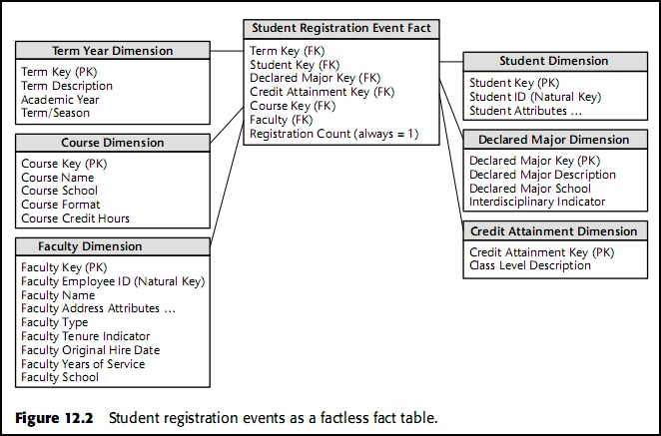
Factless Fact Examples: Education
Student Registration

Slide 81
Factless Fact Tables: Summary
Factless fact tables can also be used to analyze what didn’t happen. These queries always have two parts:
  a factless coverage table that contains all the possibilities of events that might happen
  an activity table that contains the events that did happen. When the activity is subtracted from the coverage, the result is the set of events that did not happen.
Records events which do not have associated facts
Dummy fact = 1 to increase readability of SQL queries
select faculty, SUM(registration count)….
Group By Faculty
Used in retails sales, order management, education etc.
In some situations, events that did not happen can also be recorded, but then the fact table ceases to be factless

Slide 82
Thank You
Any Questions?

